Slide 1

A Strategy for Label Alignment in Deep Neural Networks
Authors
Xuanrui Zeng
Prudhvi Eadhara
700756324

Slide 2
Motivation
• Unsupervised domain adaptation faces significant challenges due to distribution differences between source and target domains.
• Ordinary models trained on labeled source data fail to adapt well to unlabeled target data.
• A new approach is needed to align labels for improved deep neural network adaptation.
• Challenge: Domain adaptation without target labels often leads to distribution mismatch, making it hard for models trained on source data to generalize to target data.
• Prior Work: Builds on earlier work by Imani et al., which used label alignment in linear models. This paper extends that concept to deep neural networks.

Slide 3
Problem Statement
• Unsupervised domain adaptation requires models trained on labeled source domains to adapt to target domains without labels.
• The challenge lies in the distribution difference between source and target domains, where models fail to learn domain-invariant representation.
• Ordinary models do not adapt well when faced with this distribution shift.
• Core Issue: Adapting models trained on labeled source data to perform well on unlabeled target data where domain shifts occur.
• Domain Adaptation: Traditional methods focus on making features domain-invariant, but label alignment offers an alternative path, aiming to adjust the model to align with the target domain’s feature distribution.

Slide 4
Objectives
• Primary Goal: Develop a label alignment strategy for deep neural networks to improve domain adaptation performance.
• Extend the concept of label alignment from linear regression to deep neural networks.
• Propose a novel algorithm that uses label alignment to improve unsupervised domain adaptation.
• Demonstrate that the new method achieves comparable performance to mainstream approaches like ADDA and DANN.

Slide 5
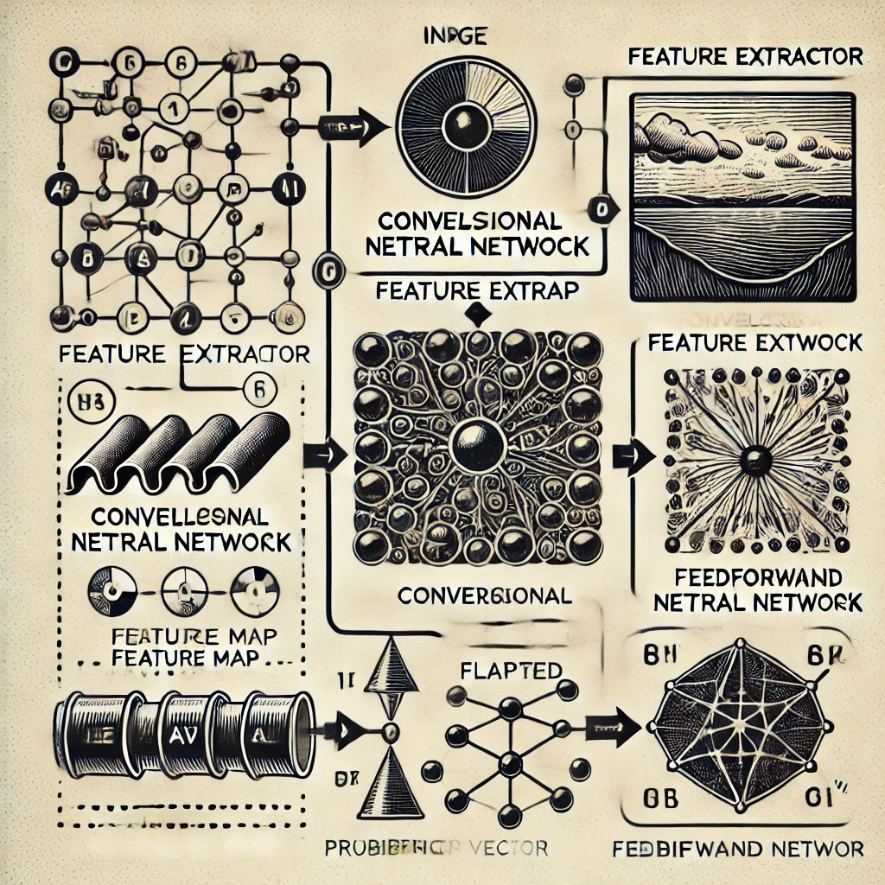
Contributions
• Generalized the label alignment technique to deep neural networks for unsupervised domain adaptation.
• Proposed a new algorithm that exploits dimensionality reduction in deep networks for better adaptation.
• Conducted experiments demonstrating stable convergence and performance comparable to other popular methods like ADDA and DANN.

Slide 6
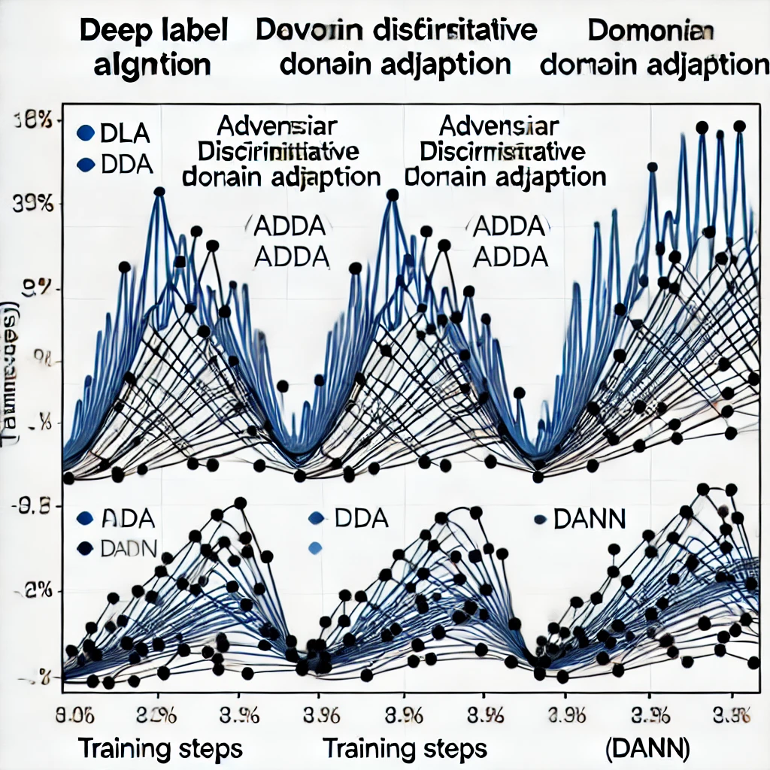
Results
• Achieved stable convergence in comparison to ADDA and DANN.
• Accuracy: 79.14% for DLA (Deep Label Alignment) compared to 78.80% for ADDA and 78.95% for DANN.
• Demonstrated improved stability in the training curve, reducing adversarial instability common in other methods.

Slide 7
Critical Analysis
Strengths:
• Achieved stable convergence, overcoming instability issues seen in adversarial methods.
• Effective for unsupervised domain adaptation using label alignment.
Limitations :
• Assumes source and target label alignment ranks are similar, which may not hold universally.
• Requires more rigorous theoretical proofs.
Future Work:
• Expand evaluation to different datasets and tasks.
• Investigate potential as a regularization method for supervised learning.

Slide 8
References
• Ganin, Y., & Lempitsky, V. (2015). Unsupervised domain adaptation by backpropagation.
• Imani, E., Hu, W., & White, M. (2021). Understanding feature transfer through representation alignment.
• Imani, E., et al. (2022). Label alignment regularization for distribution shift.
• Shlens, J. (2014). A tutorial on principal component analysis.
• Tzeng, E., et al. (2017). Adversarial discriminative domain adaptation.
• Xuanrui Zeng, 'A Strategy for Label Alignment in Deep Neural Networks,' University of Waterloo, 2024.

